Slide 1

Bridging the Gap: Comparing Employer and Educator Expectations in Small Animal Dentistry
Brock Akerman
Hanan Ali
Taylor Cesarski
Notes:
Hello and welcome to our Statistics 542 Consulting Project entitled “Bridging the Gap: Comparing Employer and Educator Expectations in Small Animal Dentistry. Our statistical consulting team includes Brock Akerman, Hanan Ali, and Taylor Cesarski.

Slide 2
Project Overview
Client: Dr. Ross-Estrada, College of Veterinary Medicine
Research Question: How do small animal primary care employers (medical directors and practice owners) and primary care veterinary educators differ in regards to their expectations of early career veterinary graduates’ competencies in small animal dentistry?
Notes:
We will be consulting with our client, Dr. Mariea Ross-Estrada from the college of Veterinary Medicine. Through our research, we aim to answer the following question: How do small animal primary care employers (medical directors and practice owners) and primary care veterinary educators differ in regards to their expectations of early career veterinary graduates’ competencies in small animal dentistry?

Slide 3
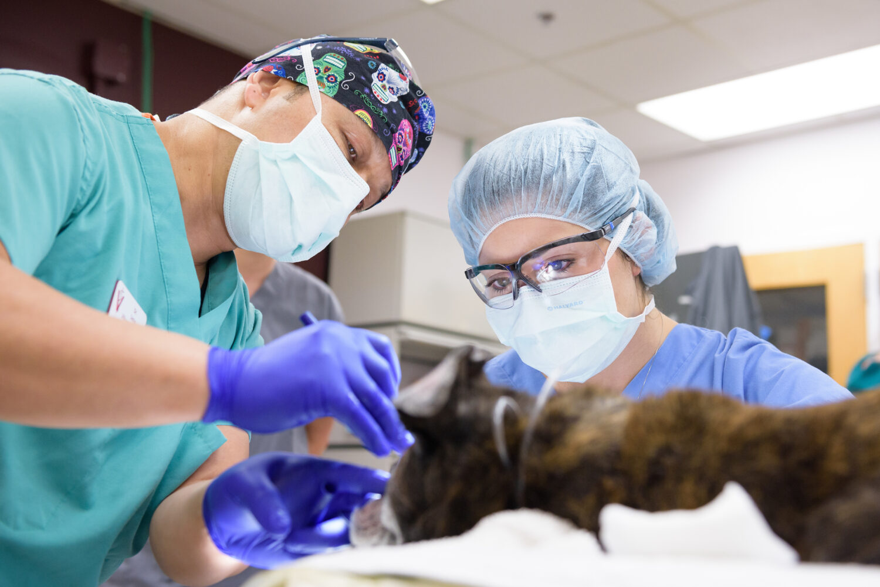
Study Motivation
Personal gaps in small animal dentistry training
Similar experiences reported by colleagues
Reliance on on-the-job training
Image source: NC State College of Veterinary Medicine, 2022
Notes:
The motivation for this research study stemmed from our client’s own experience with gaps in her education related to small animal dentistry. Many Doctor of Veterinary Medicine programs lack a board-certified dentist on staff, and Dr. Ross-Estrada discovered that her colleagues had faced similar challenges. Most had to rely heavily on on-the-job training to develop the necessary dentistry skills. As a result, our client wanted to explore whether others also perceive a gap between the competencies taught in veterinary school and the skills employers expect early-career veterinarians to possess.

Slide 4
Statistical Questions

Slide 5
Statistical Questions

Slide 6
Survey Design
Two separate surveys:
Employers (medical directors & private practice owners)
Educators (primary care veterinary faculty)
34 questions focused on procedures, hours of clinical training, and methods of training

Slide 7
Challenges and Limitations
Participant selection lacks randomization
Presence of non-response bias/survey fatigue
Survey question parameterization (lack of restrictions; multiple answers per response, no limits on integer response questions, text fields blank, etc.)
Likert scale lacks neutral response.

Slide 8
Next Steps and Timeline

Slide 9
Citations
Wheeler, B. E. (2022, July 14). College of Veterinary Medicine Expands Critical Dental and Oral Surgery Program | Veterinary Medicine News. Veterinary Medicine News. https://news.cvm.ncsu.edu/college-of-veterinary-medicine-expands-critical-dental-and-oral-surgery-program/

